Slide 1
 | Ref | target
Transport | Decrease of diesel consumption and increase of EVs and HVs XX% sale of eco-friendly vehicles* in entire vehicles for new passenger by 2030 * EVs, HVs, and Hybrid vehicles XX% sale of eco-friendly vehicles in entire vehicles for new passenger by 2050 | Scaling up deployment of various mobilities such as EVs, HVs, and LNG-fueled ships 83% sale of eco-friendly vehicles in entire vehicles for new passenger by 2030 XX% sale of eco-friendly vehicles in entire vehicles for new passenger by 2050

Slide 2
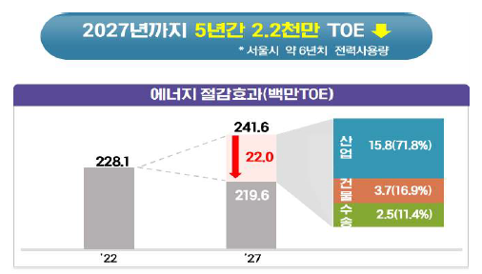

Energy Efficiency
< Energy intensity target for 2027 >
(Goal) Reducing energy intensity by 25% compared to 2019 by 2027 by reducing demand of 22 million TOE for 5 years.
(Industry) Saving 15.8 million TOE
- Innovation for large companies and public corporation
(Buildings) Saving 3.7 million TOE
- Energy cashback for household, Support for Zero Energy Buildings
(Transport) Saving 2.5 million TOE
- Scaling up development of EVs, HVs and LNG-fueled ships
Industry
Buildings
Transport
Source: Comprehensive Policy for Energy Demand Efficiency (2022)

Slide 3
Demand Outlook in Korea
(Government plans) Most of plans are close to the target scenario to achieve public policies.
(KEEI energy outlooks) Those are suggesting a demand and supply outlook to contribute policy-making.
Long-Term Energy Outlook (2000-2050, February 2023)
Mid-Term Energy Outlook (2021-2026, August 2022)
(Scenarios in the Long-Term Energy Outlook)
Reference scenario (REF): Developing energy technologies to at a similar level to the past
Energy Efficiency Improvement scenario (EEI): With rapid technical achievements in energy efficiency, achieving 50% by 2030 and 95% by 2040 compared to the 2050 target
Electrification Of End-use scenario (EOE): Slow energy efficiency technologies and stronger electrification drive

Slide 4
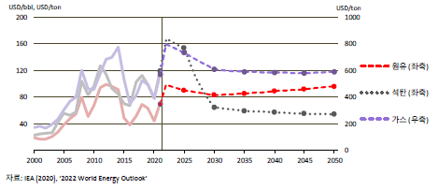
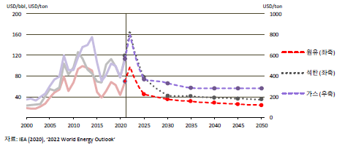
Import price presumption of coal, crude oil, and gas by scenario
< Crude Oil, Natural Gas, and Coal Import Price Outlook in REF >
< Crude Oil, Natural Gas, and Coal Import Price Outlook in TGT >
Crude oil
Crude oil
Coal
Coal
Gas
Gas
Source: IEA (2022), 2022 World Energy Outlook
Source: IEA (2022), 2022 World Energy Outlook
The energy import price was based on the international energy price of ‘WEO 2022’ by IEA.
The REF uses the STEPS price outlook and the TGT reflects the NZE price outlook.

Slide 5
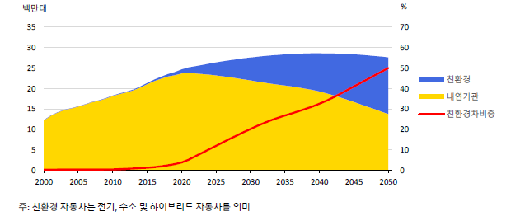
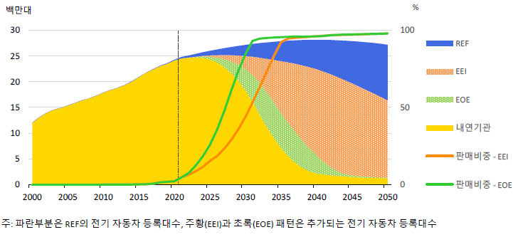
Transport (1)
< Supply and growth rate in transport by technology in REF >
< EV sales share by scenario >
Million units
Million units
REF
EEI
Eco-friendly
EOE
ICE
Portion of
eco-friendly vehicles
ICE
Sales portion - EEI
Sales portion - EOE
Note: Eco-friendly refers to electric, hydrogen and hybrid vehicles.
Note: The blue area is the number of registered EVs in REF, and the orange (EEI) and green (EOE) areas are the number of registered EVs added.
In REF, demand for transport is expected to decline due to the expansion of eco-friendly vehicles and the efficiency improvement of automobile engines.
In TGT, a key reduction measure for CO2 reduction is the phase-out of internal combustion engine and the expansion of electric vehicles.

Slide 6
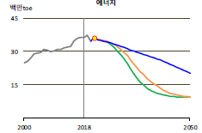
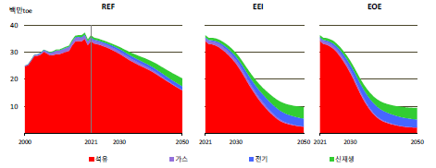
Transport (2)
< Energy demand of the transport sector by scenario >
Million toe
Million toe
Oil product
Gas
Electricity
Renewables
Demand for oil products is expected to decrease significantly and electricity with hydrogen to increase due to technological development and market regulation.
Oil demand in the domestic shipping and aviation will remain in current levels though growth is pressed by efficiency improvements.

Slide 7
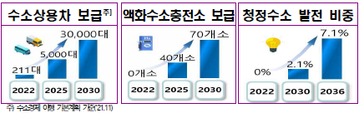
Hydrogen (2)
< Target for achieving the hydrogen economy >
Supply of hydrogen commercial vehicles*
Supply of liquefied hydrogen charging stations
Share of power generation by clean hydrogen
* In accordance with the Basic Plan for the Implementation of the Hydrogen Economy (2021)
Source: Establishing a clean hydrogen supply chain (2022)
The supply of hydrogen commercial vehicles will be activated, and infrastructure on liquefied hydrogen will be prepared.
The proportion of green hydrogen and blue hydrogen in power generation, which is 0% in 2020, will be assumed to increase to 2.1% in 2030 and 7.1% in 2036.

